Slide 1
Time Series Prediction
Algorithms and parameters compared

Slide 2
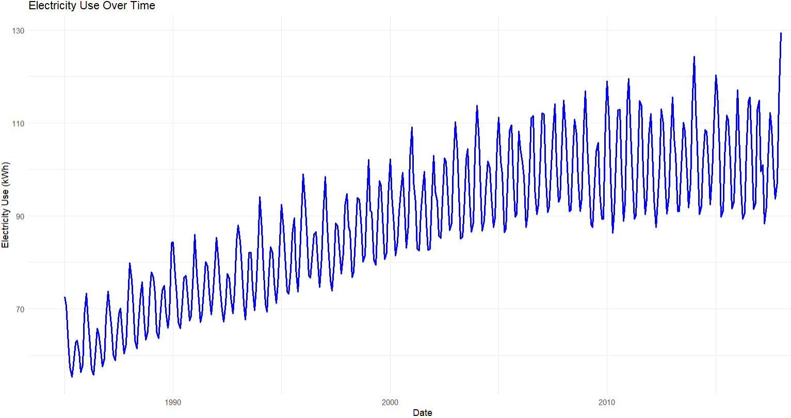
The data – Electricity Use
From Kaggle: https://www.kaggle.com/datasets/shenba/time-series-datasets?resource=download
Data is monthly from 1985-01-01 to 2018-01-01

Slide 3
We want predictions but…
Because the data is time series, correlation/regression likely won’t work
  Specifically because of autocorrelation
    Correlation/regression assume no relationship between observations, specifically no time/seasonal relationship
    Use Ljung–Box Test Statistical test for autocorrelation in residuals
      Finds autocorrelation
So what do we use instead to predict?

Slide 4
Machine learning tools we’ll examine
Decision Tree
Random Forest
Auto ARIMA (Seasonal Decomposition)
How will we compare them?
  Train-Test splits (80% train, 20% test)
  Compare each algorithms:
    R squared (predictive power)
    RSME (Root Mean Square Error)
      A statistical measure of how accurate the predictions are

Slide 5
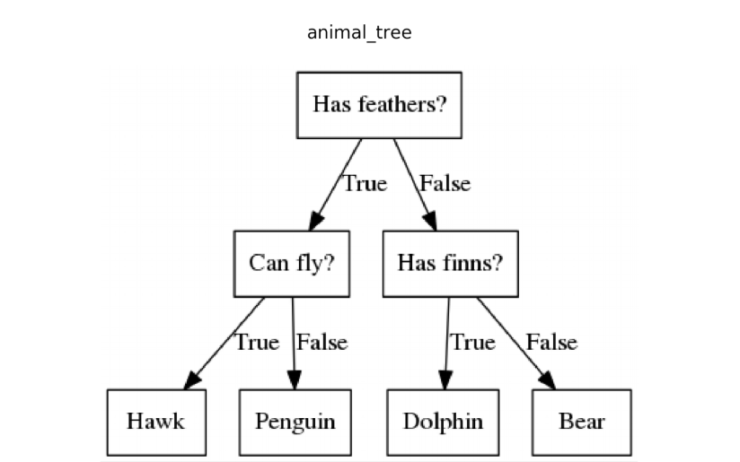
What is a Decision Tree
A decision tree works by repeatedly splitting data into branches based on predictor values until reaching simple, outcome‑predicting rules.
Show decision tree pdf
R squared – .59
RSME – 6.14
Notes:
C:\data exercises\random forest regression

Slide 6
What is a Random Forest
A decision tree builds a single set of splits to predict outcomes, which can make it simple but prone to overfitting and instability. A random forest combines many trees trained on bootstrapped samples and random subsets of predictors, averaging their results to produce more accurate and robust predictions.
Params: 500 trees
R squared – .86 compared to DT’s .59
RSME – 3.6 (compared to DT’s 6.1)
Notes:
C:\data exercises\random forest regression

Slide 7
Random Forest v2
However, I realized most trees looked the same, so I tried new param
Params: 2 trees
R squared – .83 compared to full RF’s .86)
RSME – 3.9 (compared to full RF’s 3.6)
Show Random forest tree pdf
Notes:
C:\data exercises\random forest regression

Slide 8
Why is Random Forest (even 2 trees) so much better than Decision Tree?
Bootstrap Sampling
  Random forests train each tree on a bootstrap sample (a resampled version of your training data). That resample may smooth out quirks in the data, leading to a tree that generalizes better than one trained on the full dataset.
Random Subset of Predictors (mtry)
  At each split, RF considers only a random subset of predictors. Even with few predictors, this restriction can prevent overfitting and force splits that generalize better.
Target Distribution & Noise.
  Electricity use has strong seasonal and trend signals. A single RF tree trained on a bootstrap sample may capture those signals more cleanly than an rpart tree that tries to balance bias/variance with pruning.

Slide 9
Actual difference for Random Forest tree count
Even while a random forest with 2 trees is very close in predictive power to 500 trees, what if we test that further?
  But How?
Cross validation
  Try 10 variations on how train data is split and test both types of RF’s (folds)
    *Note: these RSMEs and R2s don’t match previous results because cross validation evaluates RSME and r2 differently than normal RF analysis
    1 tree- RSME is 4.0 and r2 is .93, pretty good
    2 trees- RSME is 3.6 and r2 is .94, better
    500 trees-RSME is 2.7 and r2 is .97, even better
Every bit counts though

Slide 10
Random forest improvement
Could we make random forest work better?
  What about using lags?
  Great for teasing out strange time-series data behavior
Did adding lags help?
  No improvement in predictive quality
    Maybe it's because we have ~397 monthly observations. That’s relatively small for a high‑variance model like random forest. Adding lag features reduces the effective sample size (because the first 12 rows get dropped for lag12) and increases dimensionality. With fewer rows and more predictors, the model can overfit or become unstable.

Slide 11
Seasonal Decomposition
Purpose: Breaks a time series into three parts:
  Trend (long-term movement)
  Seasonal (repeating cycles)
  Remainder (residual noise)

Slide 12
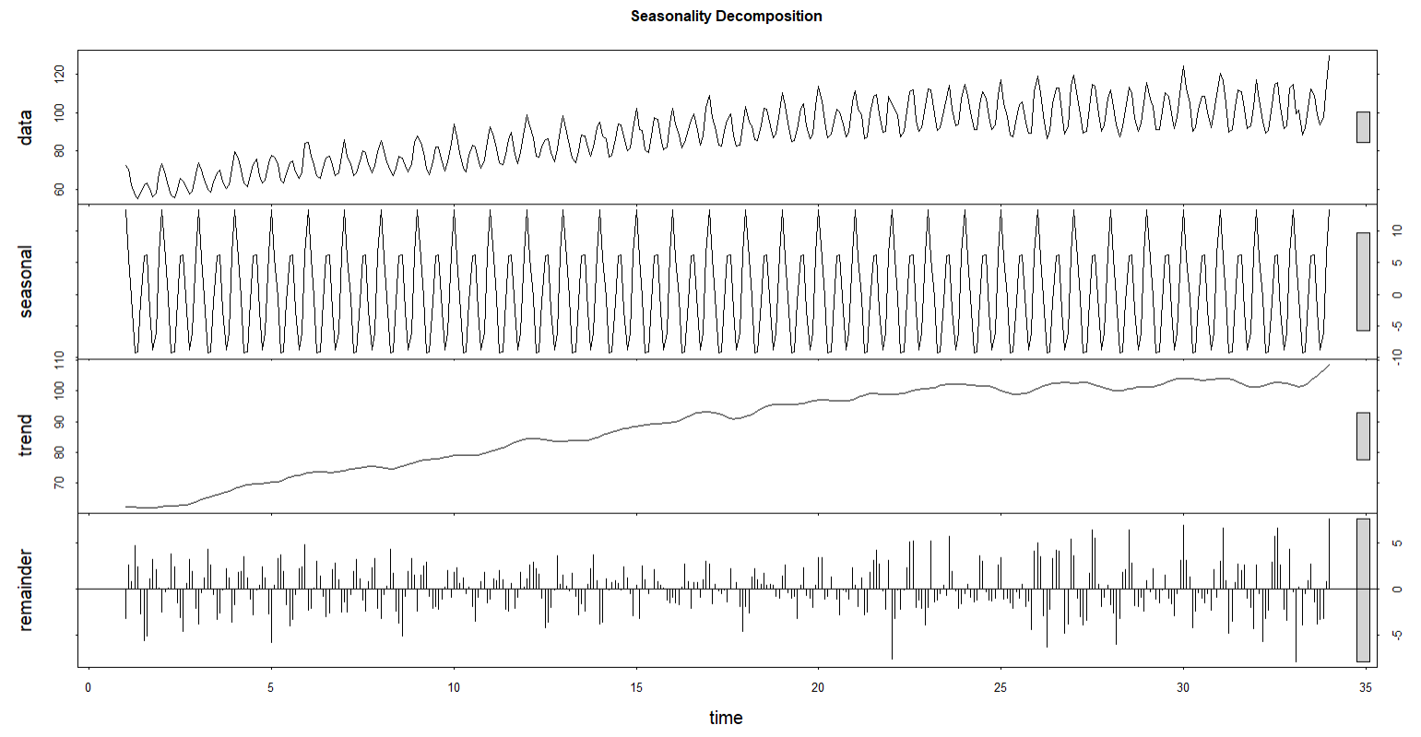
Seasonal Decomposition

Slide 13
But no seasonal decomp for predictions?
Seasonal Decomposition is just a visualizer
Auto ARIMA (Autoregressive Integrated Moving Average) is predictive: it uses the seasonal and trend information to forecast.
  They’re related because ARIMA models are designed to handle autocorrelation, differencing, and seasonality — the same structures you see visually in decomposition.
So how about the Auto ARIMA results?
  RSME – 6.8 (more than double the random forest regression of 2.7)
  R Squared - 0.49 (compared to rf regression of .86)

Slide 14
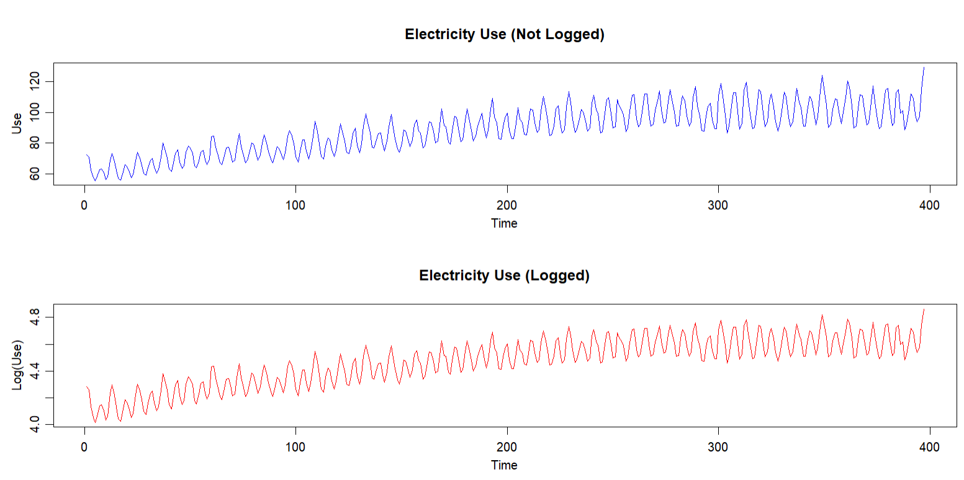
Auto ARIMA Redeemed
But what if we logged the electricity data?
  which hopefully stabilizes variance and can improve residual symmetry
  And OMG it works better
    RSME: 4.1 (compared to RF’s 2.7)
    R Squared – 0.82 (compared to RF’s .86, not bad)
The log transformation doesn’t radically change the shape of the data, but it stabilizes variance, improves residual behavior, and makes ARIMA assumptions more valid, which leads to better RMSE and R² — even if the plots look deceptively similar.

Slide 15
Analyses Compared
Analysis | RSME | R Squared | Rank (predictive power)
Decision Tree | 6.14 | 0.59 | 4
Random Forest (500 trees) | 3.6 | 0.86 | 1
Random Forest (2 trees) | 3.69 | 0.83 | 2
Auto ARIMA | 6.8 | .49 | 5
Auto ARIMA (logged) | 4.1 | .82 | 3

